Slide 1
Predicting Airbnb prices in US Cities
Riyaz Ali Mohammad
Nov 2020

Slide 2
Every Airbnb host wants to know the price at which he wants to list his property.
But there is no way to guess the prices that are suitable to both hosts and guests, unless you look deep into the numbers.

Slide 3

Is there a solution to this problem?
By utilizing the data available about the listings and their corresponding prices, a Machine learning model could be built that could predict the prices that are suitable for hosts and guests.

Slide 4

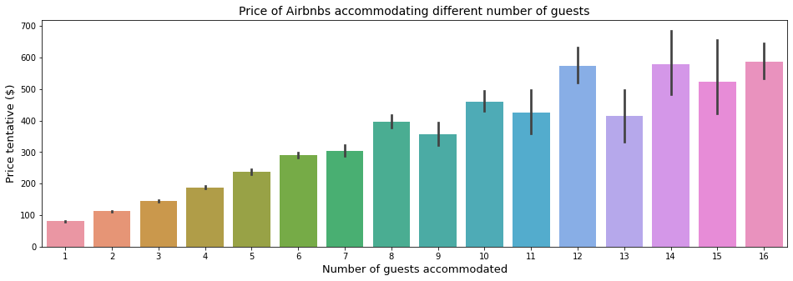
The more people you accommodate, better rates for your listing!
It’s suggested to allow up to 8 guests. Inviting more members than that, would be futile.

Slide 5
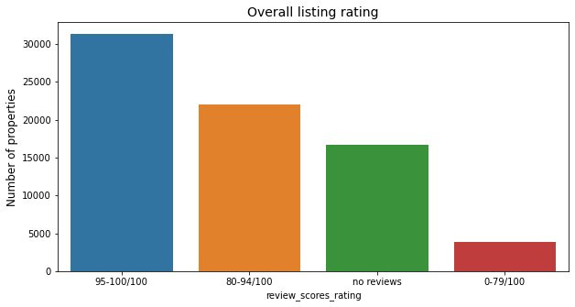
See how the listings are rated. Make sure the guests love your lisitng too!

Slide 6
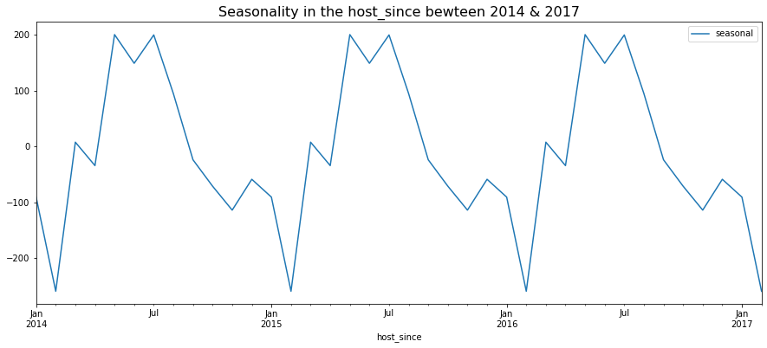
Look at the period of the year when the listings are high in demand. Make sure you’re ready by the time summer holidays arrive.

Slide 7
From the description of amenities available in the data, we have created multiple features to better predict the price.
List of features created from amenities:
check_in_24h
air_conditioning
high_end_electronics
privacy
breakfast
essential_electronics
Security
white_goods
Elevator
child_friendly
Facilities
hot_tub_sauna_or_pool
pets_allowed

Slide 8
We’ve removed some variables from the data that aren’t contributing to the model built.
Description
Neighbourhood
zipcode
city
first_review
last_review
host_since
Beds
High_end_electronics

Slide 9
The list of models we’ve fit the data to
Linear Regression
Ridge Regression
Decision Trees
Random Forests
Gradient Boosting Regressor
Extreme Gradient Boosing Regressor

Slide 10
Model that has been selected based upon metrics
Extreme Gradient Boosting Regressor is selected to predict the prices.
Hyper Parameters used in the model are:
'n_estimators': [50,100,200,500,700,1000],
'max_depth': [2,3,4,5,6],
'min_samples_split':[2,5,10,15,20,25],
'learning_rate': [0.01,0.1,0.5,1],
'loss': ['ls','lad','huber']

Slide 11
The model performance could be improved by selecting the best parameters available to boost the model
Implemented Randomized search CV to tune the hyper parameters
The best parameters we deduced from the cross validation is as follows:
subsample: 0.7
n_estimators: 700
Max_depth: 6
Gamma: 0.7
Col_sample_bytree: 0.7

Slide 12
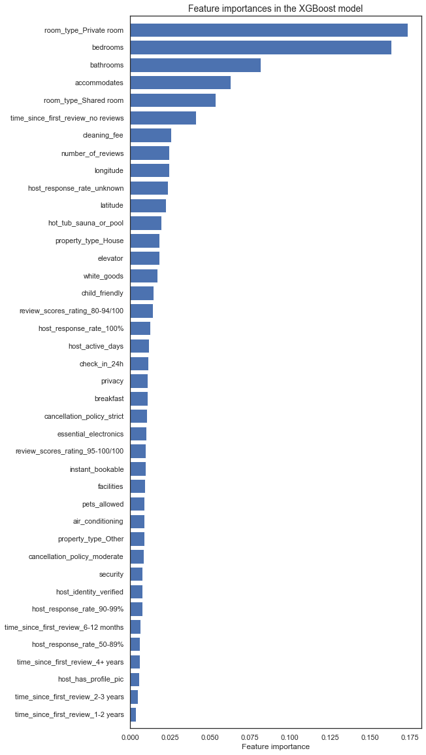
Features that contribute to learning are

Slide 13
Conclusions and recommendations
The Machine learning model was able to explain 58% variation n the price with the RMSE of 107.58
The remaining 40% is probably made up of text features present in the data.
By incorporating NLP and deep learning, rest of the variance in price could be explained, but it could be computationally expensive.

